Slide 1
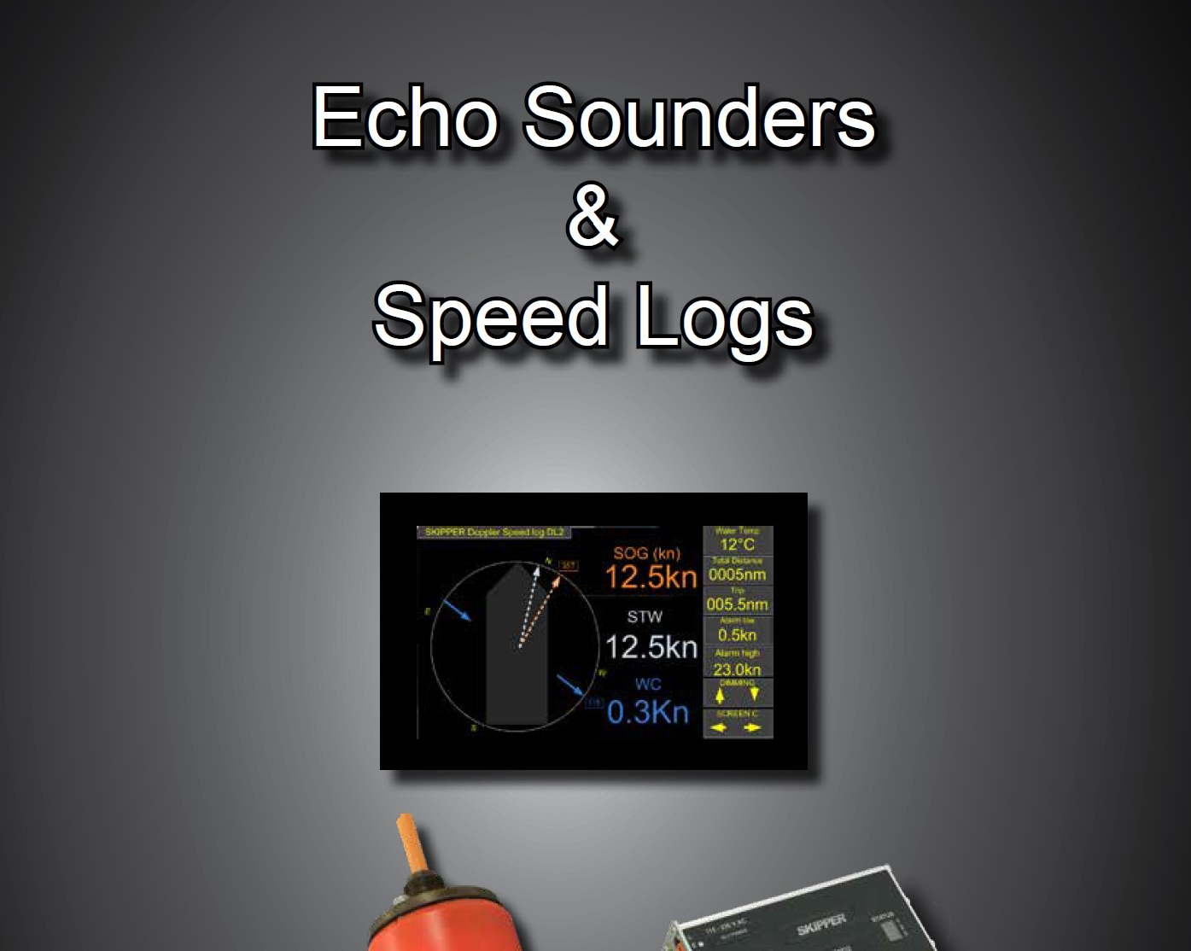
Product Presentation
For Dealers and Customers

Slide 2
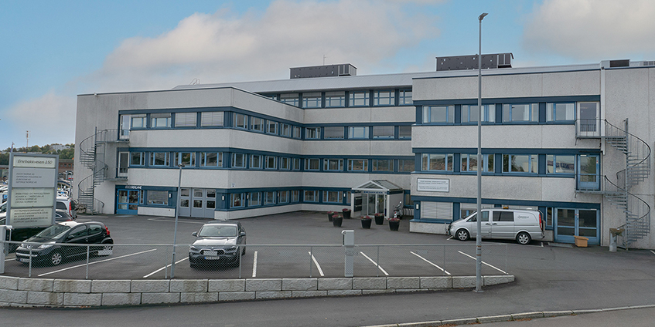
The history of the SKIPPER brand
SKIPPER was established as an import brand within SIMRAD in 1973
SKIPPER Electronics become a separate company in 1984
Started with trade of echosounders, moved to production of Echosounders and Speed logs
Today more than 95% is produced by SKIPPER in Oslo, Norway
June 2023 SKIPPER was acquired by Jotron AS, and is now Jotron SKIPPER AS, keeping the brandname and Product logo

Slide 3
Quality Standards
Jotron SKIPPER approves its system for SOLAS, MED, and local approvals when required
ISO9001:2015
Wheelmark MED D / MED B
DNV, BV, ABS, Lloyds, CCS, RMRS, Rina, MER and NK

Slide 4
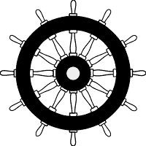
Echosounders
ESN100 – Single Channel
ESN200 – Dual Channel

Slide 5
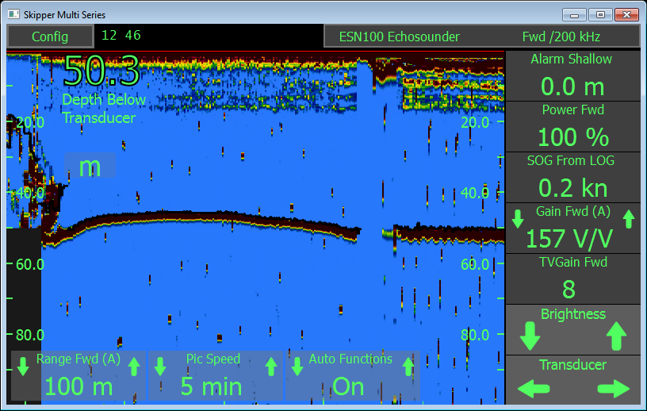
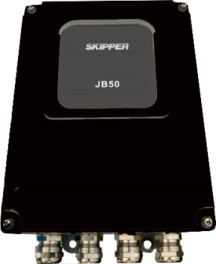
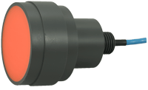
ESN100 Single channel Echosounder
IMO Wheelmarked Echo Sounder
Just what you must have, no extras.
50 or 200 kHz and 50/200 kHz
9” Touch display
24 hours memory
NMEA 0183 and LAN from display
Alarms
Transducer installations:
  Steel tank, Icetank, Aluminium tank, seavalve for double and single bottom mounting, retrofit ELAC mounting

Slide 6
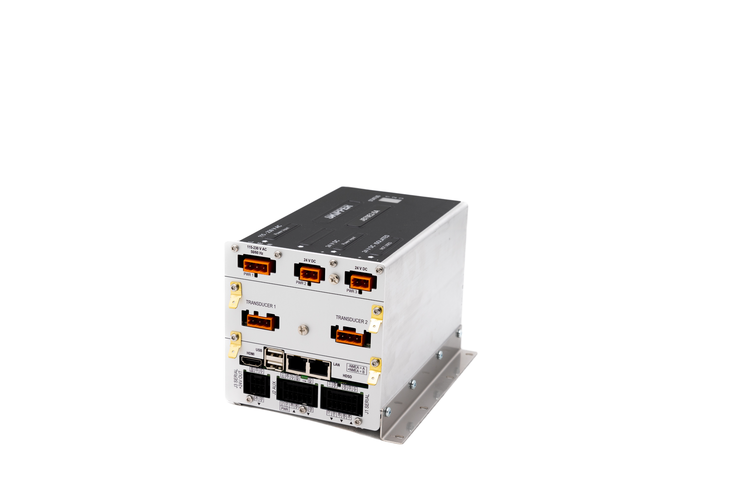
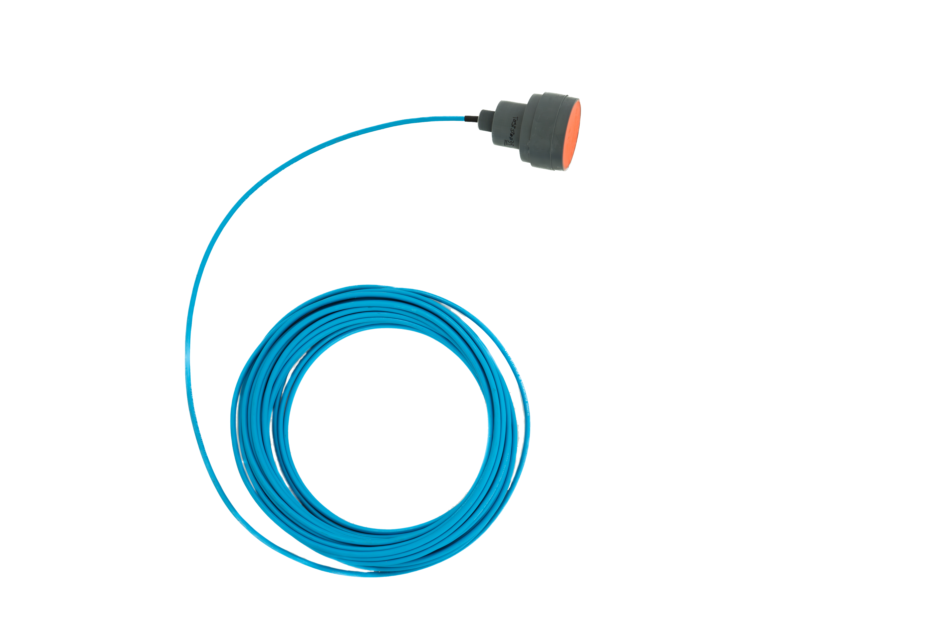
ESN200 Dual channel Echosounder
IMO Wheelmarked Echo Sounder
24, 30, 33, 38, 50, 100, 200, 210 kHz and 50/200 kHz
Two simultaneous channels
9” Touch display (Multiple screens)
10.1” from 2024
Printer output
Remote diagnostics
Other options (Synch)
24+ hours memory Internal, SD or USB
2 x LAN, 4 x NMEA 0183 and 3 x auxiliary
Alerts
Transducer installations:
  Steel Tank, Ice Tank, Aluminium Tank, Sea Valve for double and single bottom mounting, Elac retrofit

Slide 7
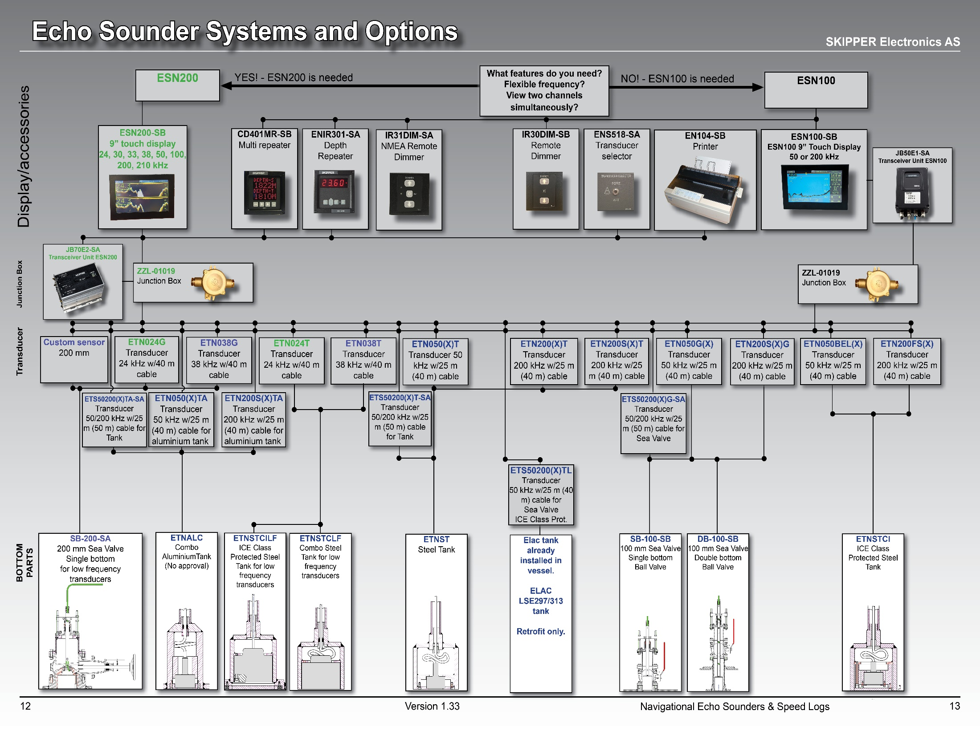
Product selector
IMO Wheelmarked Echo Sounder
Select the Bottom mounting
Select the Echosouder
Find out which transducers can be used

Slide 8
Speed logs
SKIPPER EML 124/224 Compact Electromagnetic
EML 1100/1200 Graphic Electromagnetic STW
SKIPPER DL1 Single axis Doppler
SKIPPER DL2 Doppler
SKIPPER DL21 Doppler
SKIPPER SATLOG SL1200
SKIPPER Digital Speed Log Repeater

Slide 9
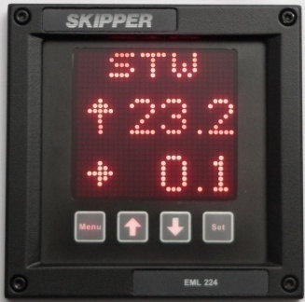
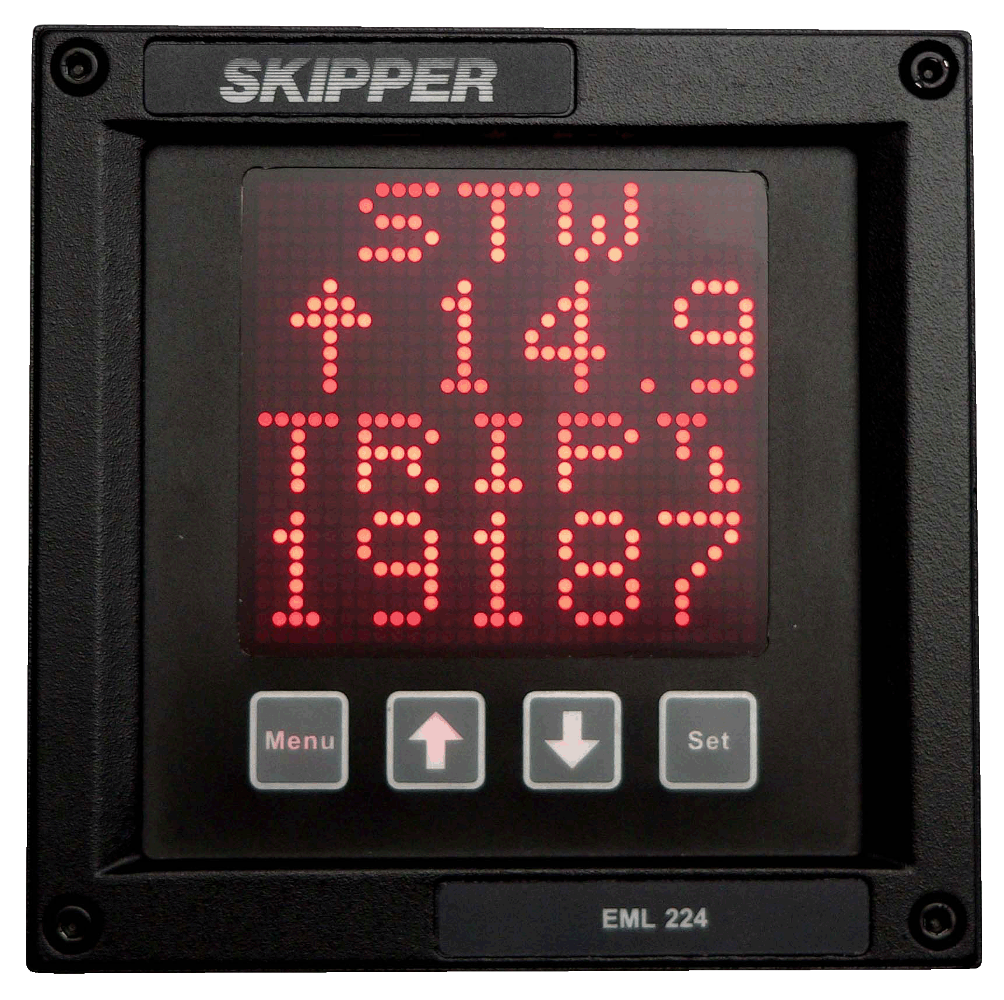
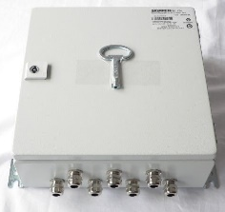
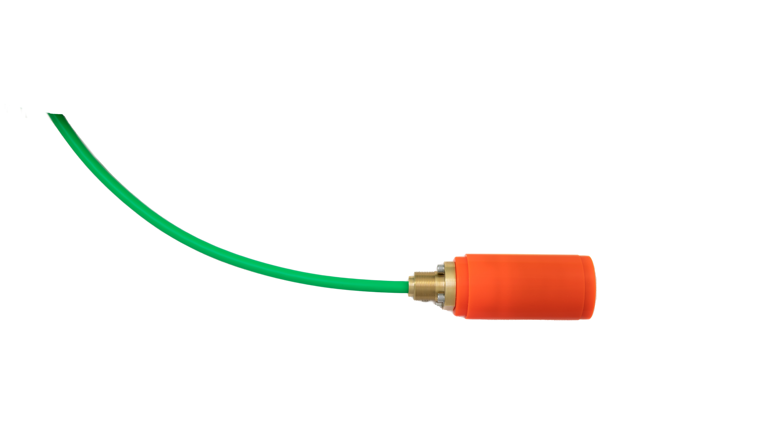
EML124/224 Electromagnetic Speed Through Water (STW) speed log
IMO Wheelmarked Electromagnetic Speed Log
Compact display
  144x144mm
1 or 2 axis STW Speed Log
Water temperature
60mm Sensor installations:
  Tank, Sea Valve for single and double bottom mounting

Slide 10
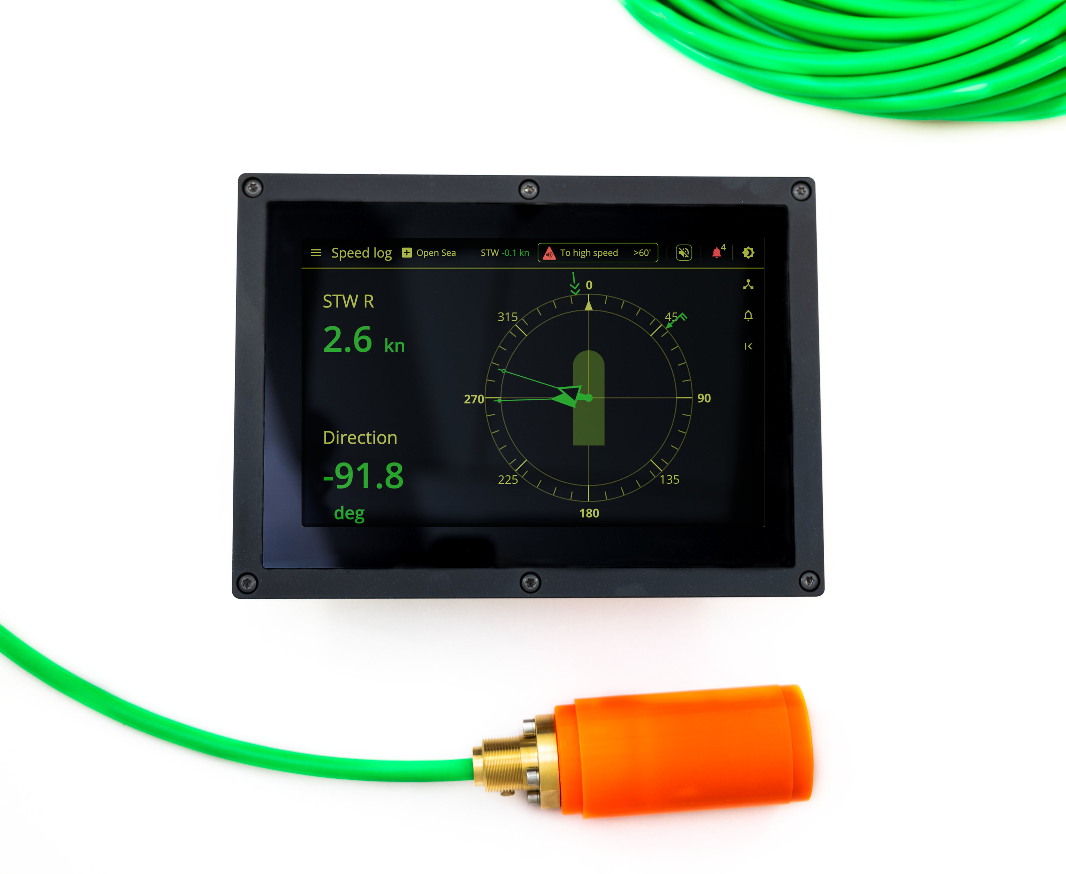
EML1100/1200 Electromagnetic Speed Through Water (STW) speed log
IMO Wheelmarked Electromagnetic Speed Log
10.1” display with Openbridge web interface
  Multiple screens
  Dual network
  Auxilliary out (Pulse, speed limit, alert)
  BAM standard alerts
1 or 2 axis STW Speed Log
Optional use of Electronic unit (JB40POW, or JB60N2)
Water temperature
60mm Sensor installations:
  Tank, Sea Valve for single and double bottom mounting, retrofit versions

Slide 11
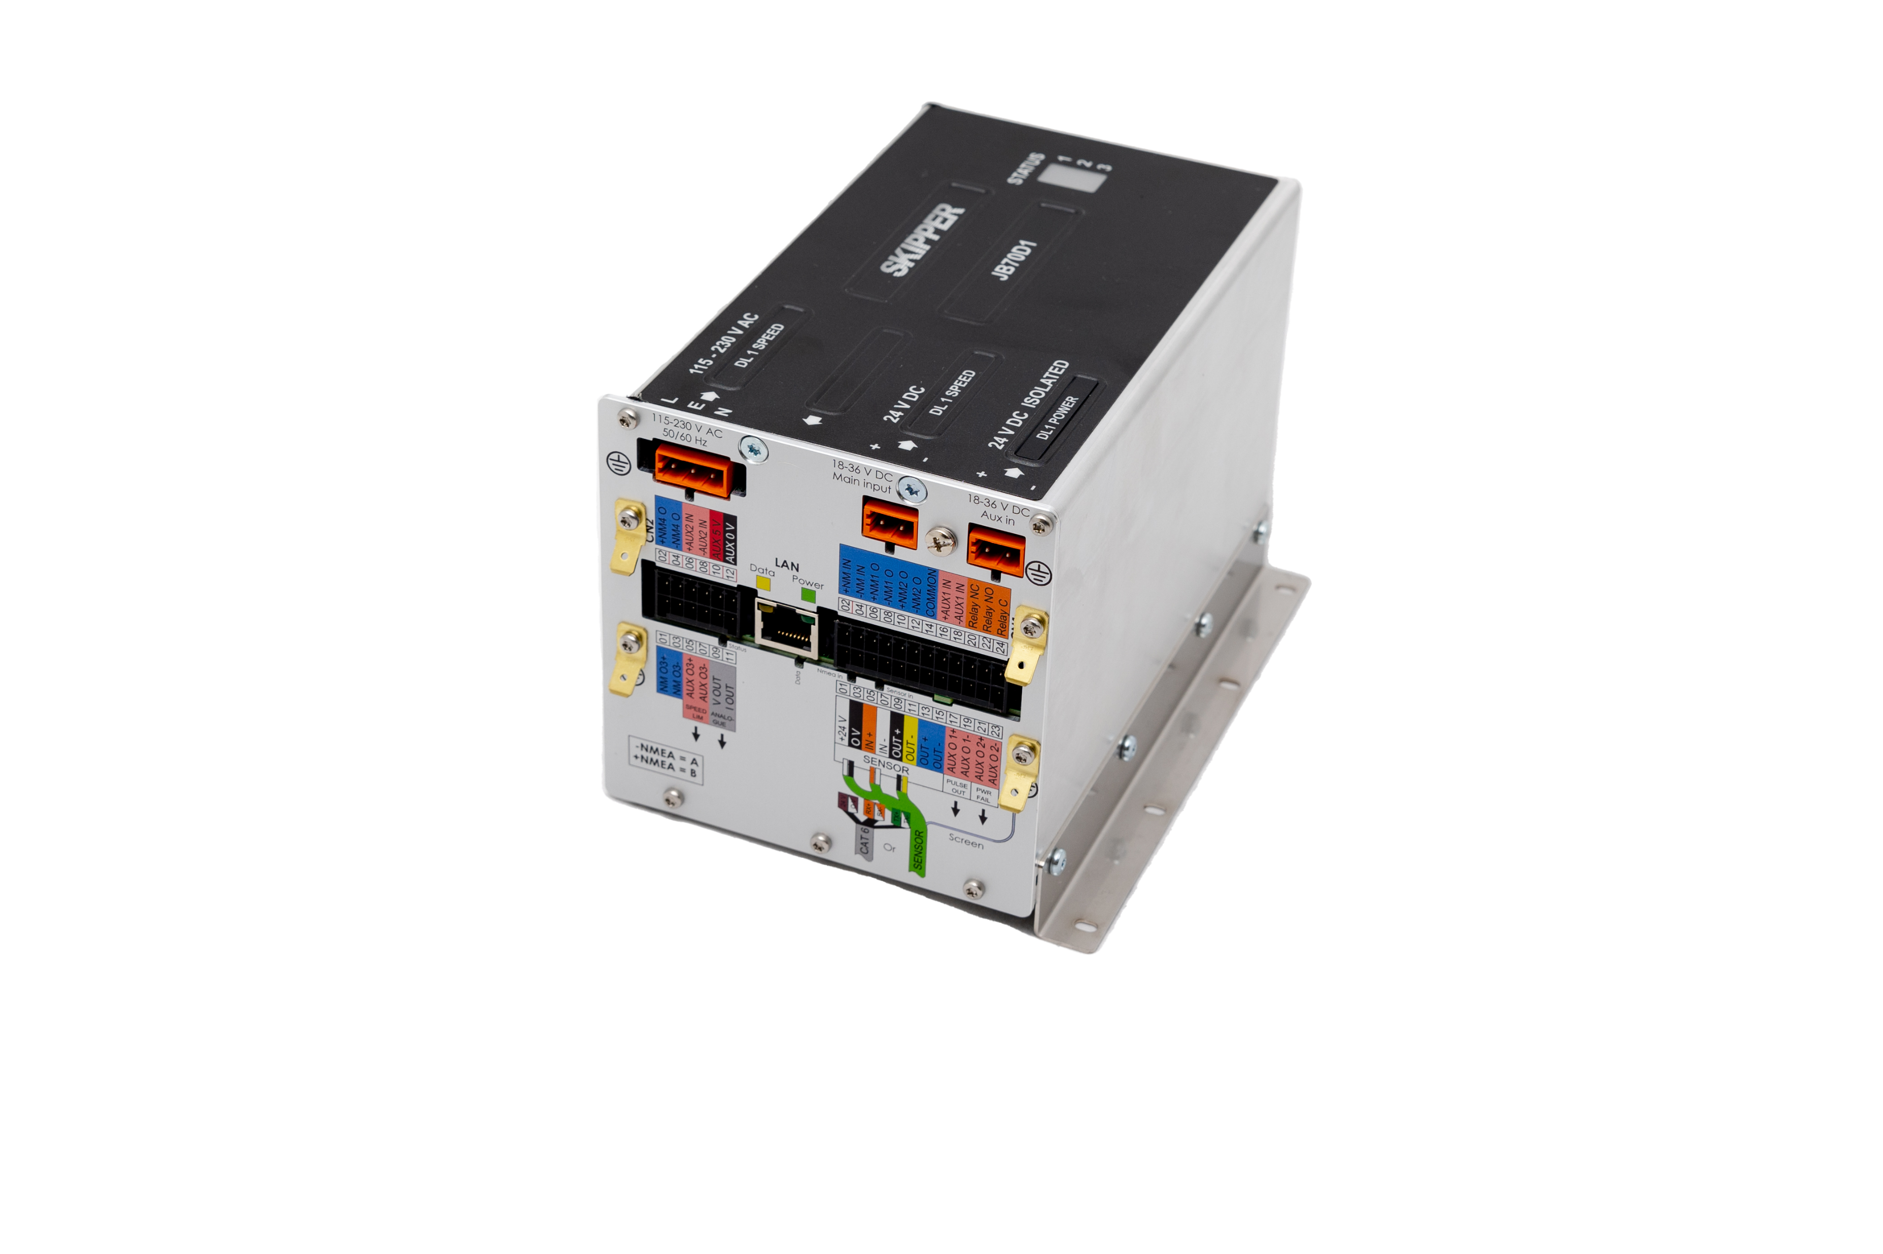

DL1 Multi, Speed Through Water (STW) single axis speed log
IMO Wheelmarked Doppler Speed Log
Compact display
  144x144mm
One axis STW Speed Log
Water temperature
60mm Sensor installations:
  Tank, Sea Valve for single and double bottom mounting

Slide 12
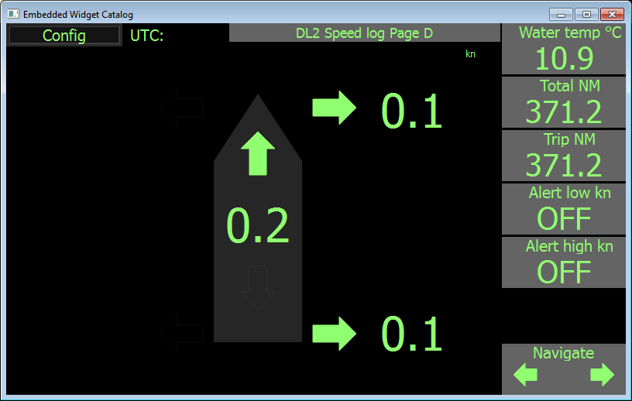
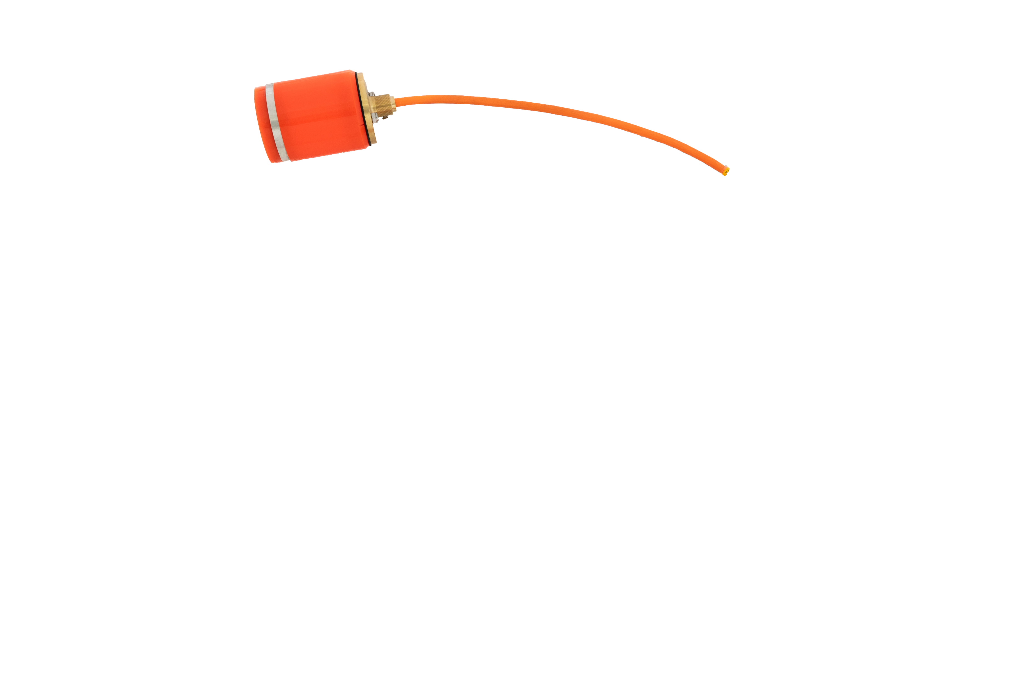
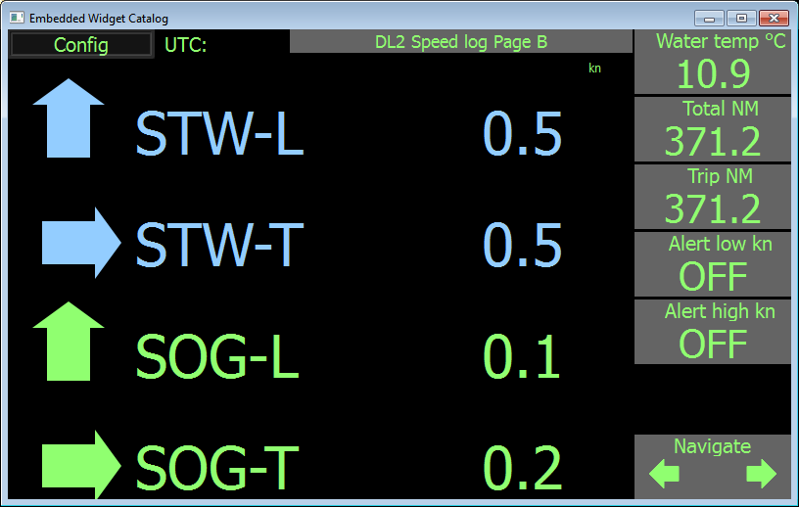
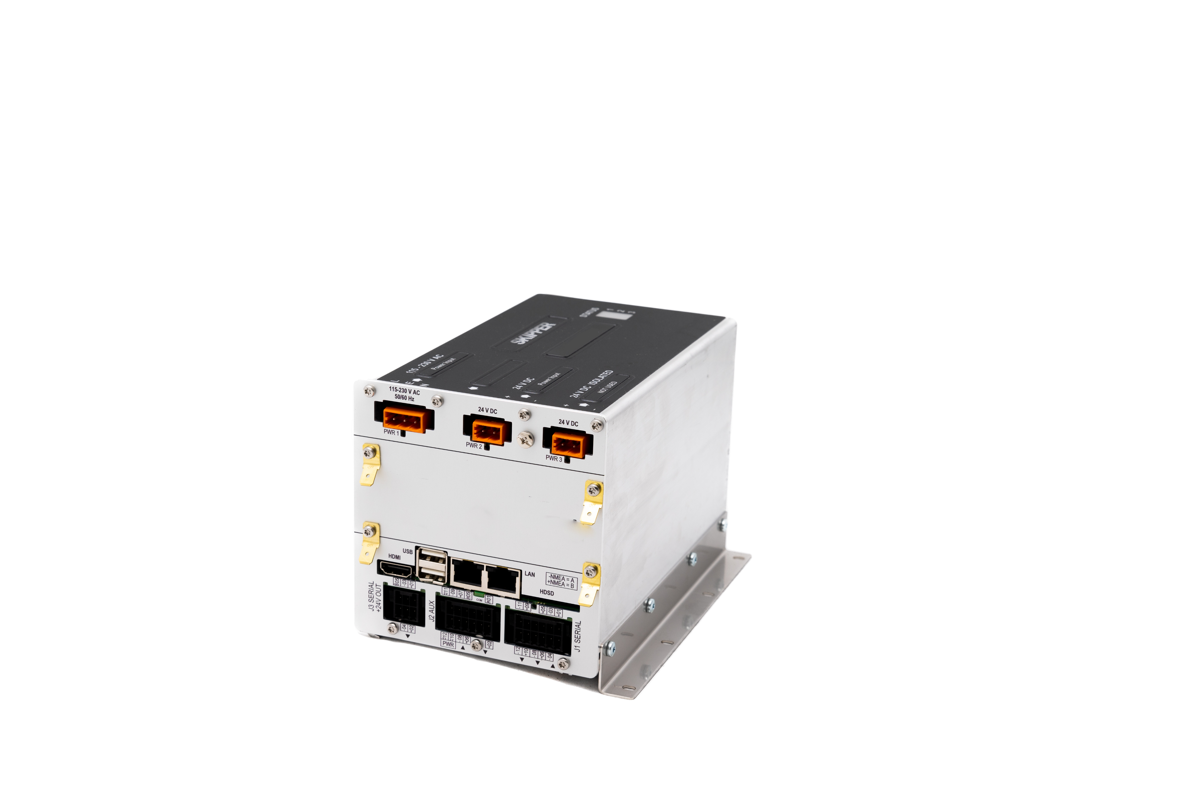
DL2 Dual STW and Speed Over Ground (SOG)
IMO Wheelmarked Doppler Speed Log
9” Touch display (Multiple screens)
  (10.1” from 2024)
Dual axis Speed Log with docking functionality
Speed through Water (STW)
Speed over ground (SOG)
Water temperature
100mm Sensor installations:
  Sea Valve for single and double bottom mounting, and retrofit

Slide 13
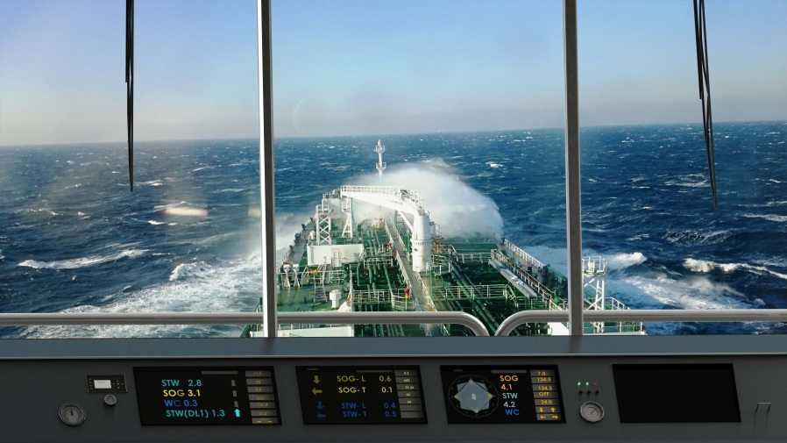
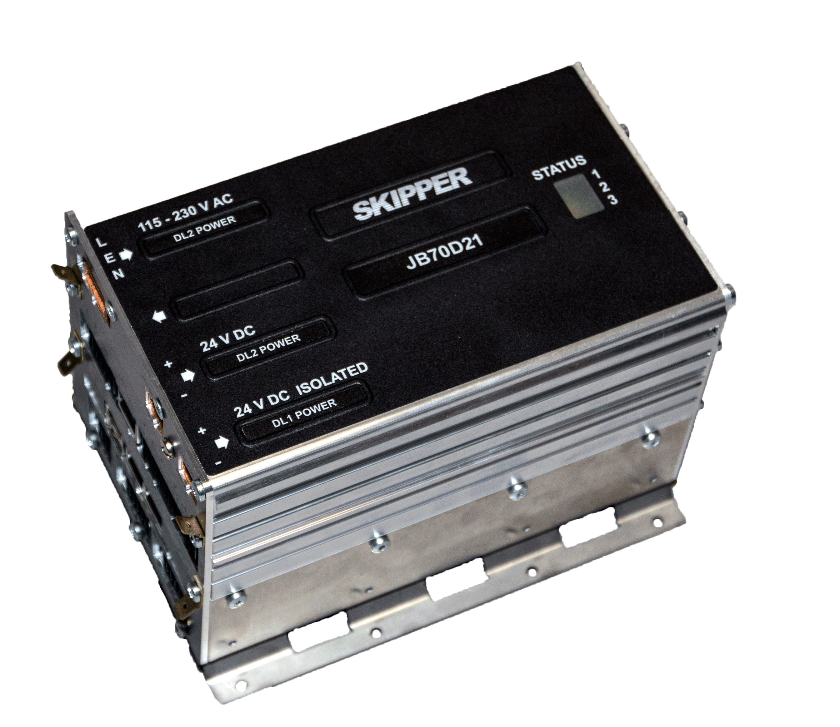
DL21 Dual STW and Speed Over Ground (SOG)
IMO Wheelmarked Doppler Speed Log. According to IMO resolution MSC334(90)
Vessels above 50 000 dwt
9” Touch display / Dot matrix
Dual axis Speed Log
Additional single axis speed log
Speed through Water (STW)
Speed over ground (SOG)
Water temperature
Sensor installations:
  Sea Valve for single and double bottom mounting

Slide 14

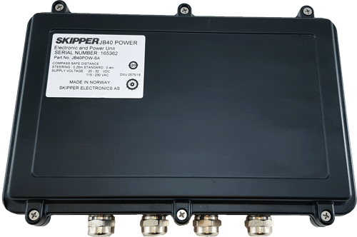
SL1200 Satlog
IMO Wheelmarked SATLOG
9” Touch display
Dual axis Speed Log
Speed Over Ground (SOG)
Dual GPS antenna
NMEA0183 and LAN

Slide 17
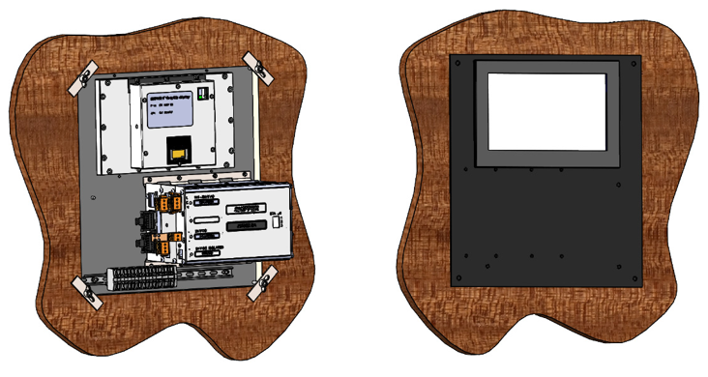
Retrofit
Jotron SKIPPER aims for Form-Fit-Function
  GDS / DL850 Displays were larger so we get a display adapter, This adapter can contain the 9” screen and JB70 electronic unit
  The new 10” screen will only contain the screen and is best suited for the Mini (screen only) versions
In most cases cabling can be reused

Slide 18
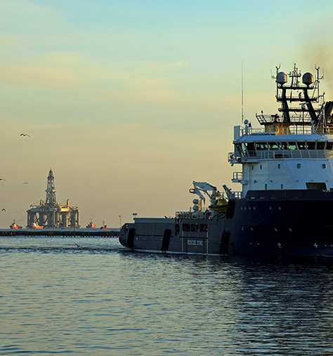
Support Products
Anemometer
Repeaters
Switches
Expanders

Slide 19
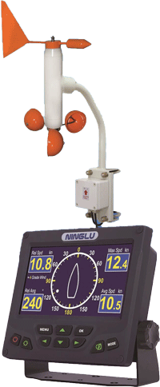
Ninglu AM706 Marine Anemometer
High Resolution Wind Speed (0,1 m/s)
Wind direction (1 degree)
Temperature resistant
Moisture and salt proof mechanic design
7” High brightness LCD display
Digital and analog display

Slide 20
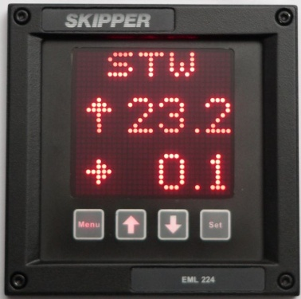
CD401 Multirepeater
Digital repeater
2 NMEA inputs
Integrated dimmer
Flexible mounting
External dimmer
Modes:
  • Depth – below surface, keel and transducer
  • Speed – over ground and through water
  • Distance – total/trip for both groundspeed and waterspeed
  • Heading – true, magnetic and relative
  • Rotation – rate of turn and direction
  • Wind – speed and direction (true, magnetic and relative)
  ^{• Temp. – water and air}
  • Drive – RPM, propeller pitch and rudder position
  • Clock – UTC, local time and expected time of arrival

Slide 21
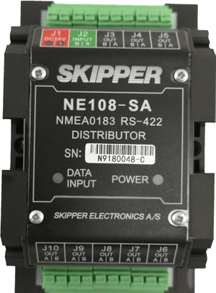
NE-108-SA NMEA Expander
^{1 input and 8 outputs}
Galvanic isolated NMEA expander
Approved for IEC60945 (2002+C1 2008)
^{Mounting in 35mm DIN IEC60715}

Slide 22
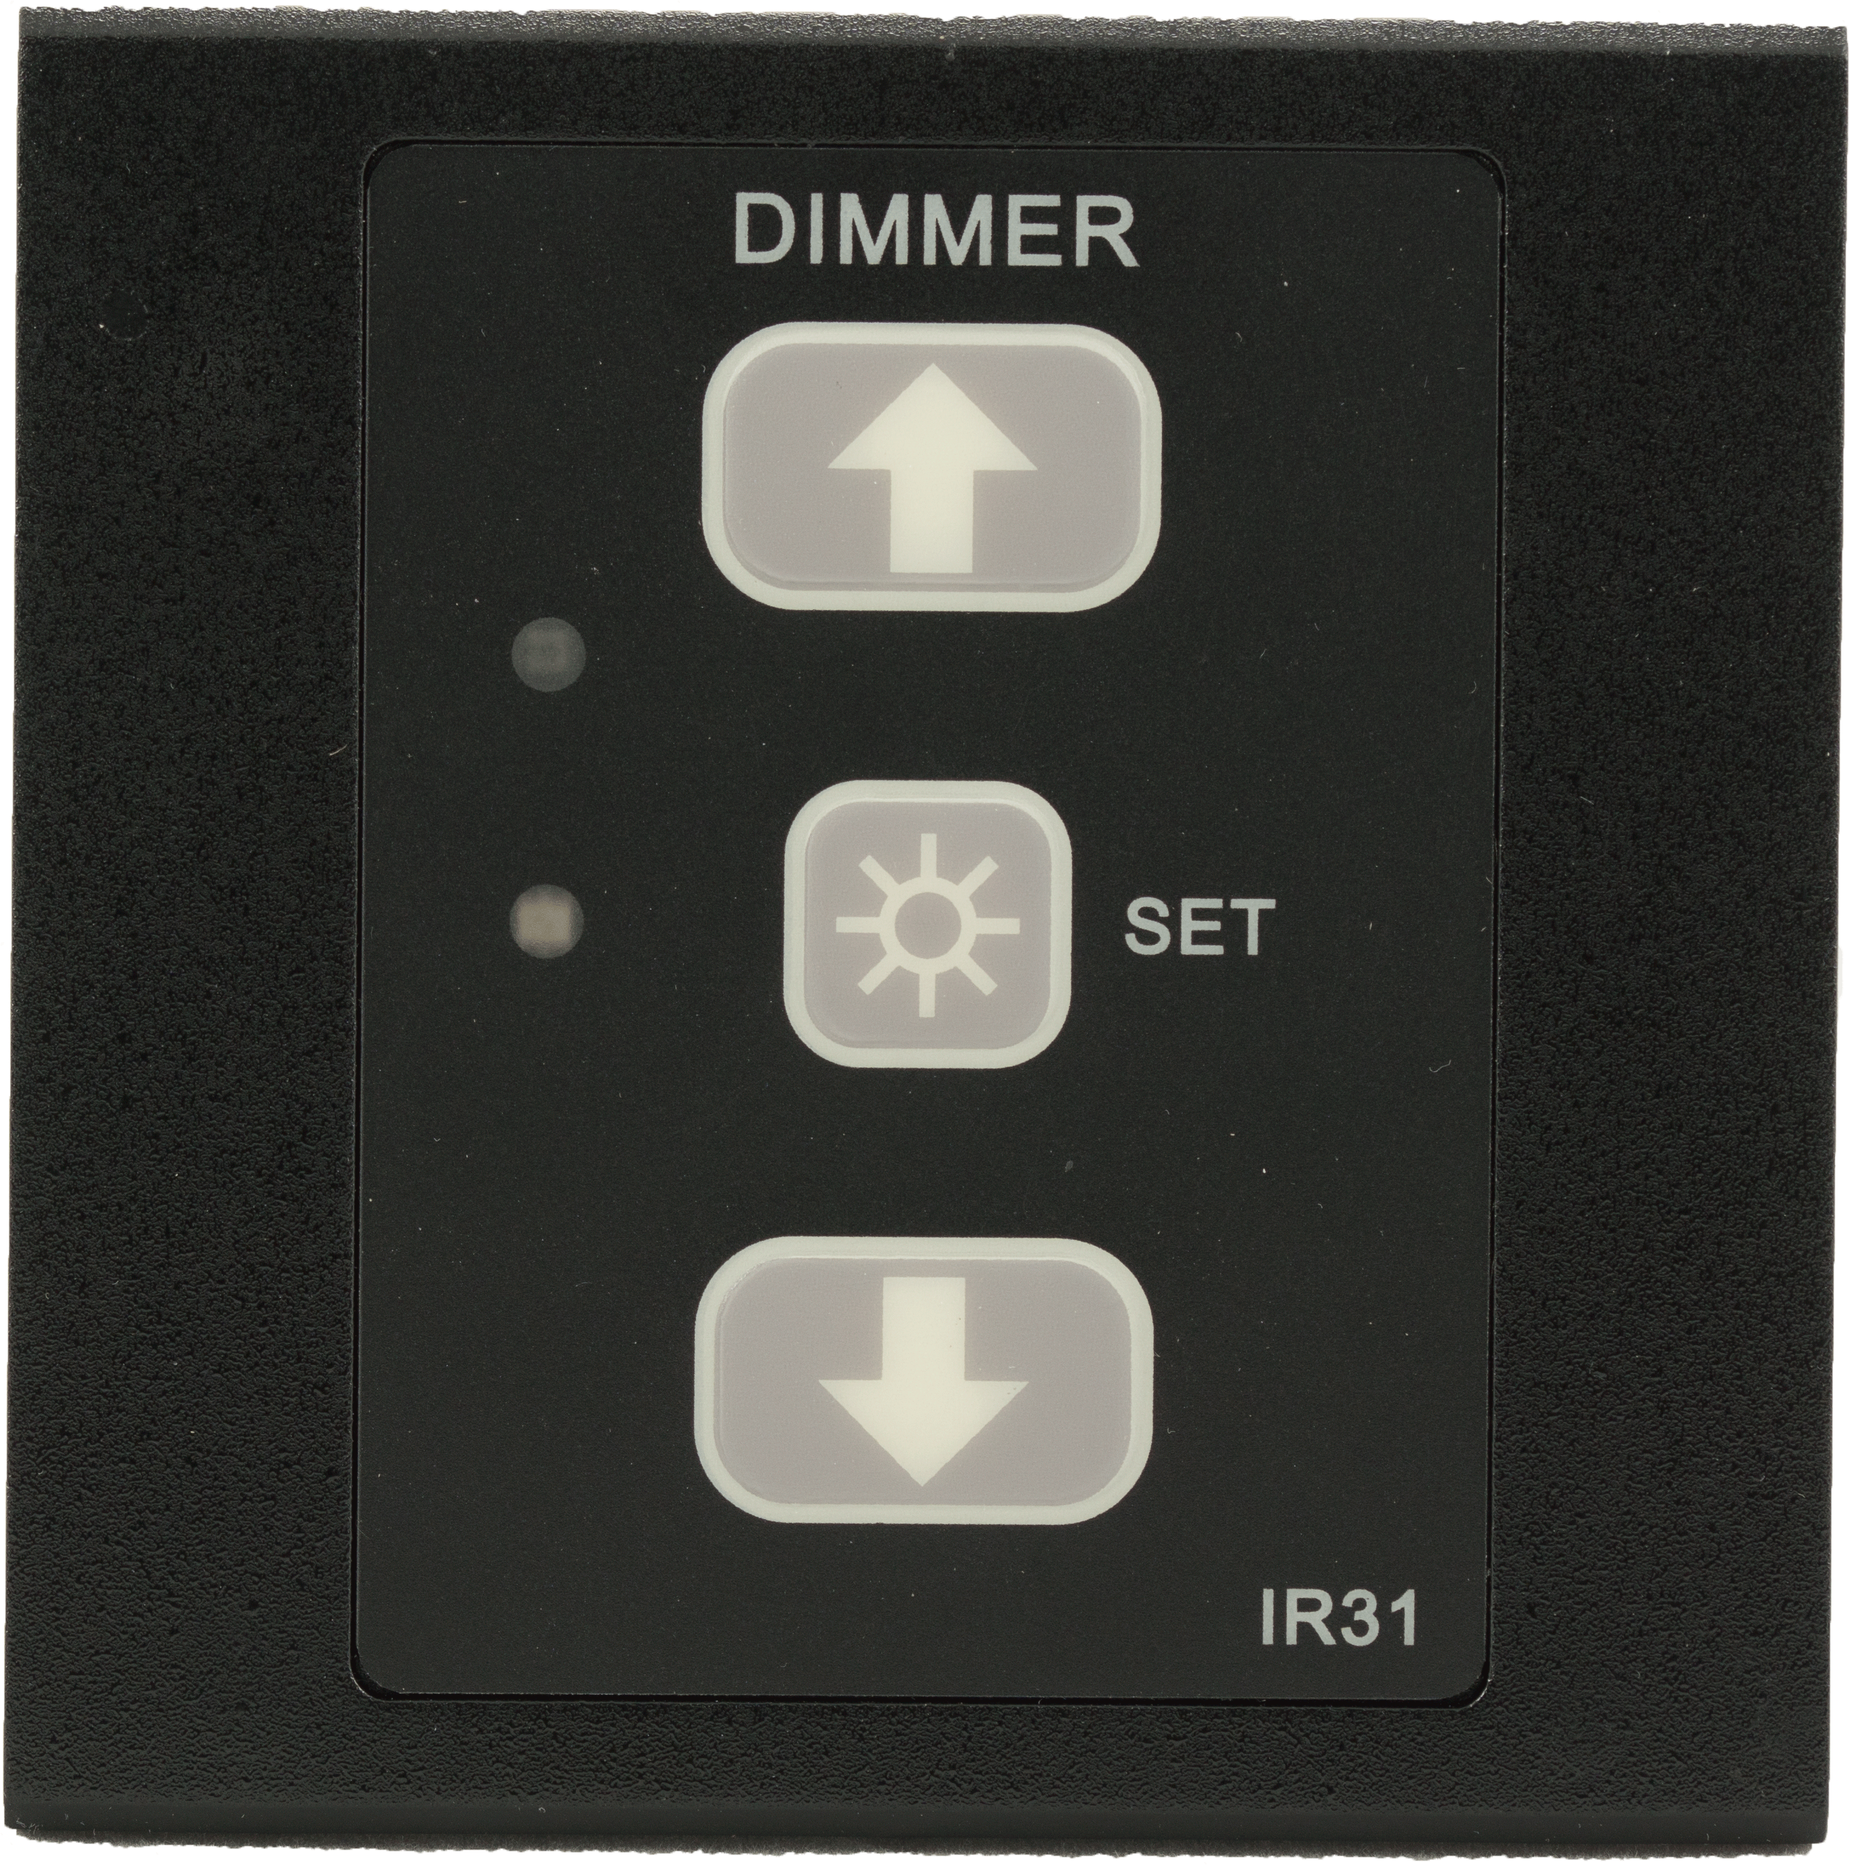
IR31DIM-SA NMEA Dimmer
2 Channel input/output NMEA dimmer
Multiplexes NMEA messages onto input messages
Pulse Dimmer
Auto Light detection with internal or external light sensor
DDC or proprietry message, programmable using SKIPPER Service software
May be used on all Jotron SKIPPER, or other products

Slide 23
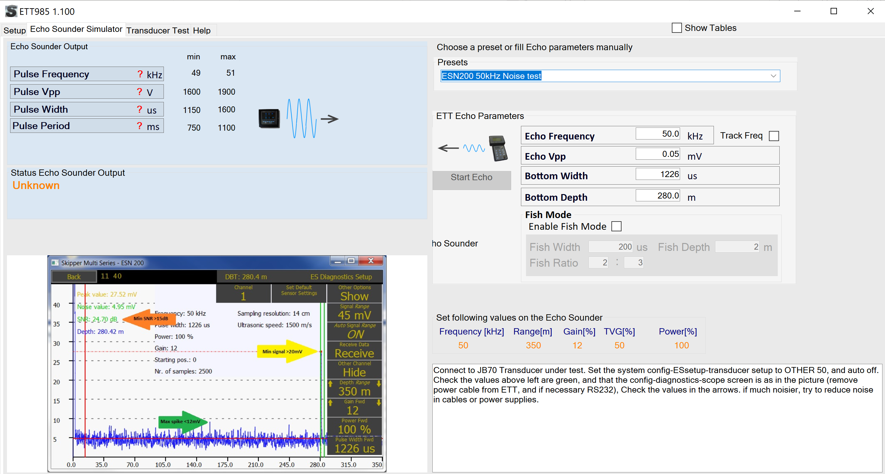
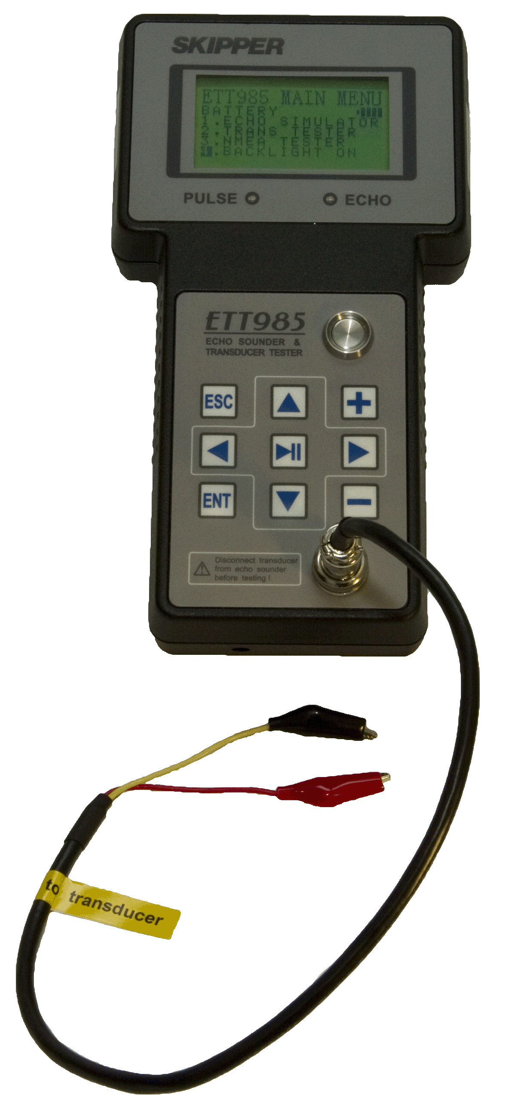
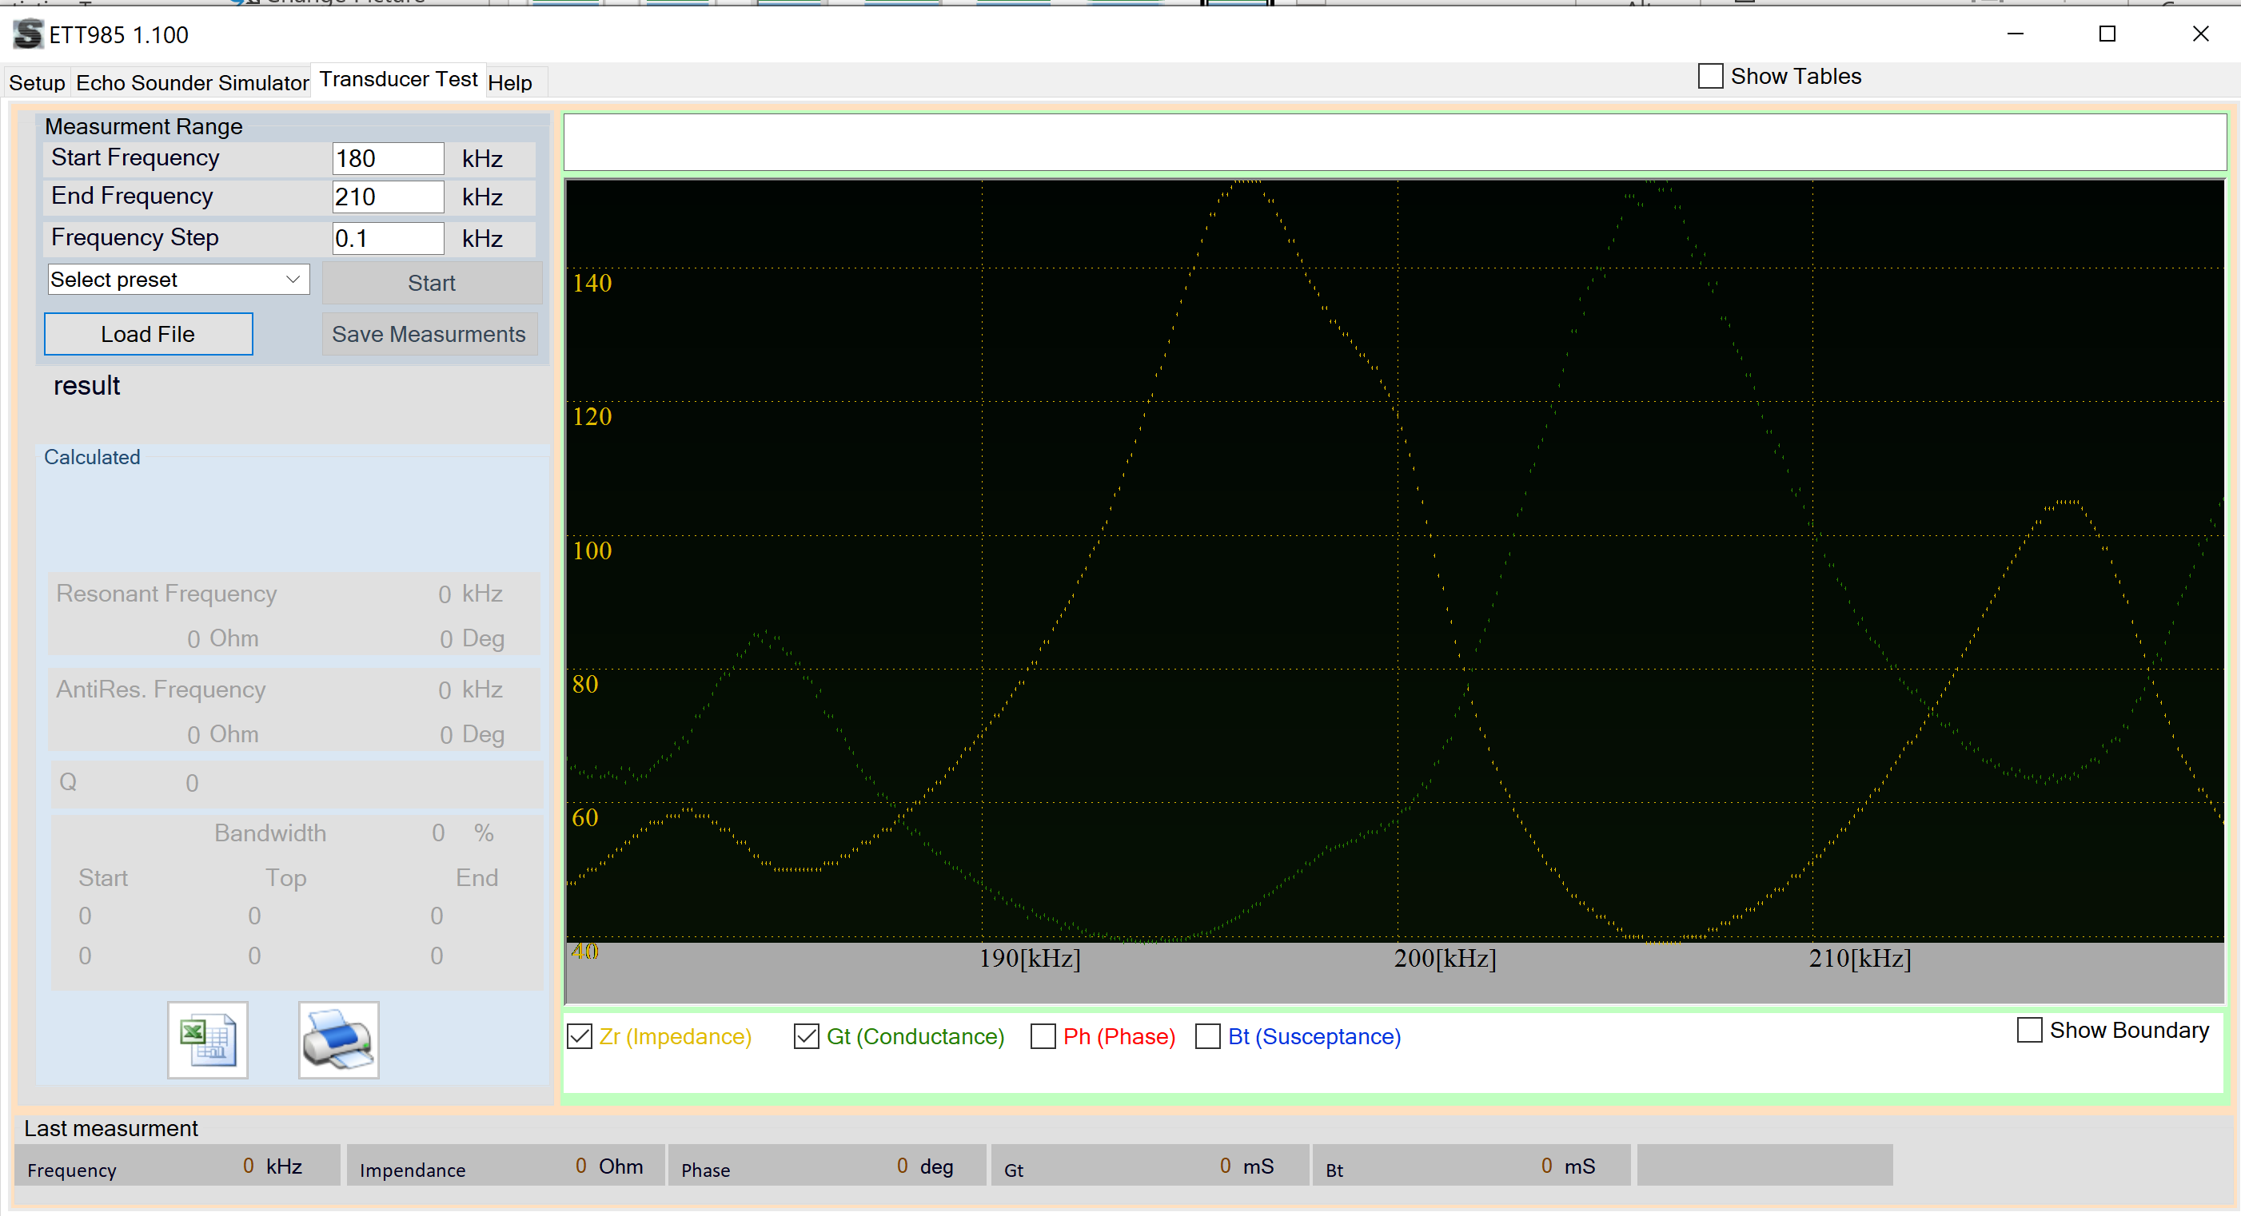
ETT985 Transducer, Echo Sounder and NMEA tester
Tester for Echosounder transducers (10-1000kHz), giving impedance results and pass/fail.
Simulator for Jotron SKIPPER and other manufacturer Continuous wave Echosounders
NMEA monitor
Stand alone operation with pre-programmed Pass/Fail Criteria for Jotron SKIPPER Transducers
Integrated to SKIPPER Service software for firmware and test criteria values
Software option to view full transducer impedence Values
Ideal tool to diagnose errors on echosounder systems, reducing unnecessary service changes.
Programmable with non Jotron SKIPPER transducers

